Slide 1
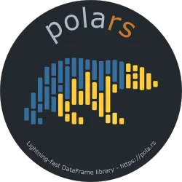





Python Polars
Polars is an exciting new DataFrame library for Python that offers blazing fast performance and an intuitive API. Built on Rust and leveraging Apache Arrow, Polars provides efficient data processing capabilities, especially for large datasets. This presentation will introduce you to Polars' key features and demonstrate how it can supercharge your data analysis workflows.
By Prajwal Narayanaswamy

Slide 2




Getting to Know Polars
Polars combines the flexibility of Python with the speed of Rust, making it ideal for a wide range of data processing tasks. Its core is written in Rust, providing memory efficiency and performance on par with C or C++. Polars utilizes all available CPU cores in parallel and supports large datasets without requiring all data to be in memory.
Fast Performance
Parallel Processing
Leverages Rust for speed and efficiency
Utilizes all available CPU cores
Large Dataset Support
Handles data larger than available memory

Slide 3

Why Polars Matters:
Performance Boost: Polars is designed to be blazing fast. It utilizes Rust's inherent advantages to outperform traditional Python libraries, particularly for large-scale data operations.
Multi-Threading: Unlike single-threaded libraries like Pandas, Polars takes full advantage of all available CPU cores, enabling parallel processing and significant speedups in computation.
Memory Efficiency: Polars optimizes memory usage using Arrow's columnar format, ensuring that even datasets larger than your system's memory can be processed seamlessly.
Modern Features:
Lazy Evaluation: Deferred execution allows optimization of the entire query plan before running it.
Integration: Polars supports multiple file formats (CSV, Parquet, JSON) and databases, making it versatile for various data workflows.

Slide 4
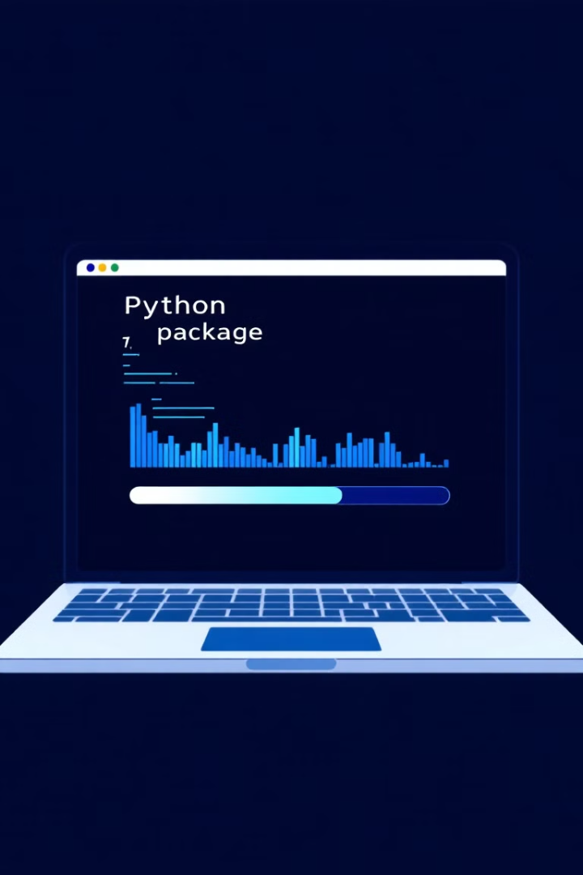
Installing Polars
Getting started with Polars is straightforward. You can install it using pip, the Python package installer. For basic functionality, simply run pip install polars. To access additional features, you can install Polars with specific feature flags.
1
Basic Installation
Run pip install polars for core functionality
2
Feature Flags
Install with pip install "polars[numpy, pandas]" for integration with NumPy and pandas
3
Full Installation
Use pip install "polars[all]" to install all optional dependencies

Slide 5

DataFrames, Expressions, and Contexts
Polars introduces powerful concepts for data manipulation: DataFrames, expressions, and contexts. DataFrames are the core data structure, similar to pandas. Expressions allow you to perform operations on columns, while contexts determine how expressions are evaluated.
DataFrames
Expressions
Contexts
Two-dimensional data structures composed of rows and columns
Computations or transformations performed on data columns
Environments in which expressions are evaluated, such as select, filter, or groupby

Slide 6





Working with Polars DataFrames
Polars DataFrames offer a familiar interface for data manipulation. You can create DataFrames from various data sources, perform operations, and explore data efficiently. Polars provides methods like .schema, .head(), and .describe() for quick data inspection.
Create DataFrame
From dictionaries, CSV files, or other sources
Inspect Data
Use .schema, .head(), and .describe() methods
Manipulate Data
Perform operations using expressions and contexts
Analyze Results
Explore and visualize processed data

Slide 7






The Lazy API: Optimized Queries
Polars' lazy API is a powerful feature that allows you to specify a sequence of operations without immediately executing them. This enables query optimization and efficient processing of large datasets. LazyFrames are the core objects in the lazy API.
LazyFrame Creation
1
Define query without immediate execution
Query Optimization
2
Polars optimizes the execution plan
Efficient Processing
3
Execute optimized queries on large datasets
Results Collection
4
Retrieve final results when needed

Slide 8


Scanning Data with LazyFrames
Polars' scan functionality allows you to process large datasets stored in files without reading all the data into memory. This is particularly useful when working with CSV files or other large data sources. Polars creates a LazyFrame that references the file's data, optimizing both memory usage and computation time.
Memory Efficiency
Optimized Queries
Process data larger than available RAM
Execute only necessary operations
Flexible Data Sources
Work with CSV, Parquet, and more

Slide 9




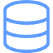

Integration with External Data Sources
Polars seamlessly integrates with various data sources and file formats. It can read and write CSV, JSON, Parquet, Avro, Excel, and connect to databases. This flexibility allows you to use Polars in diverse data processing workflows.
CSV
JSON
Parquet
Databases
Read and write comma-separated values
Work with JavaScript Object Notation
Efficient columnar storage format
Connect to various database systems

Slide 10

Next Steps with Polars
As you've seen, Polars offers powerful capabilities for data processing in Python. To continue your journey with Polars, explore advanced features like joins, melts, pivots, and time series processing. Polars' integration with cloud computing platforms also opens up possibilities for large-scale data analysis.
Explore Advanced Features
1
Joins, melts, pivots
Time Series Processing
2
Efficient handling of temporal data
Cloud Integration
3
Leverage cloud computing platforms
Contribute to Polars
4
Join the open-source community

Slide 11

THANKYOU

